Slide 1
Collaborative Platform 5.0
Team Members
Product Owner
Jorge Travieso
Adrian Alfonso
Juan Caraballo
Spring 2015

Slide 2


Sprint #1 Planning
24 Story Points
16 Story Points

Slide 3
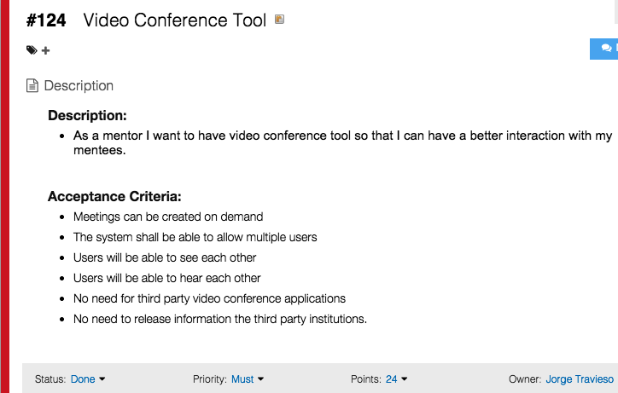

Slide 4
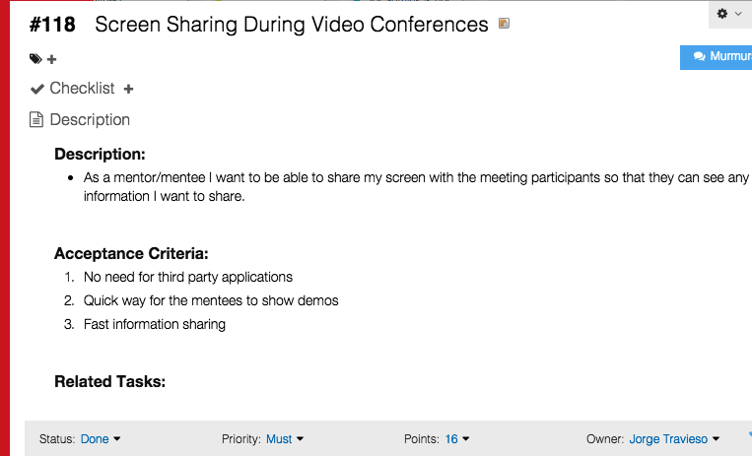

Slide 5
Sprint #1 Planning
User stories divided into tasks
1 hour equivalent to 1 story point
Planned 36 story points in total

Slide 6
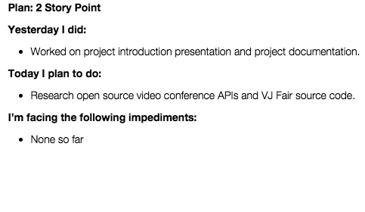
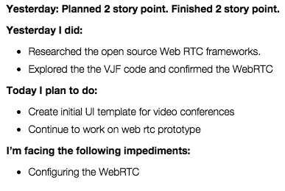
Daily Scrums
Day 2
Day 3

Slide 7
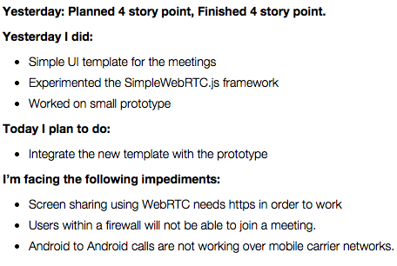
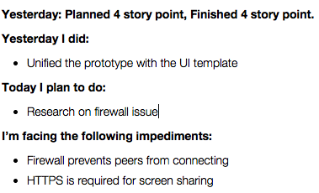
Daily Scrums
Day 4
Day 5

Slide 8
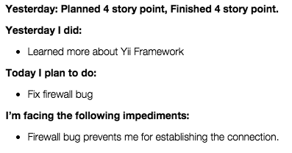
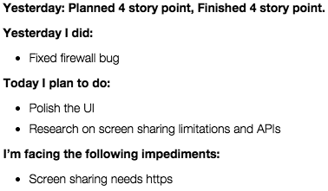
Daily Scrums
Day 6
Day 7

Slide 9
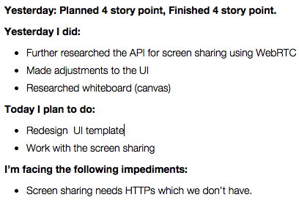
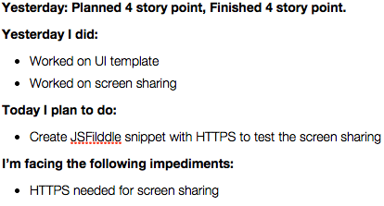
Daily Scrums
Day 8
Day 9

Slide 10
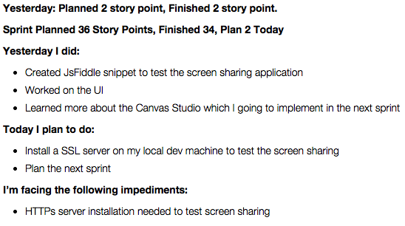
Daily Scrums
Day 10

Slide 11
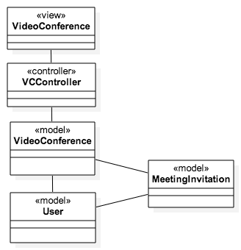
Updated VC Model

Slide 12
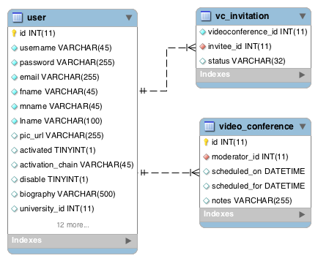
Updated EER Diagram (VC)

Slide 13
Sprint #1 Recap
All users stories planned were completed
Personal Mark: 36 Points
Team Mark: 69 Points

Slide 14
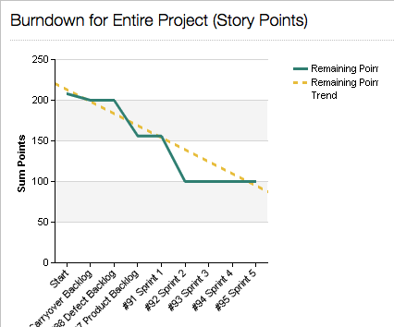
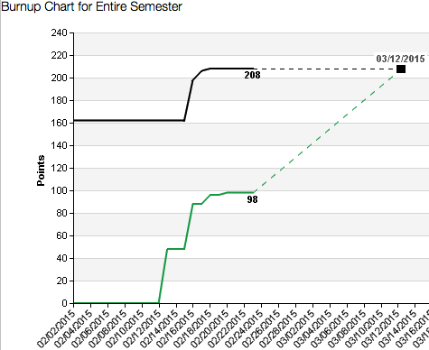
Charts

Slide 15
Demo
https://cp-dev.cis.fiu.edu/cotools/sscreen.html

Slide 16
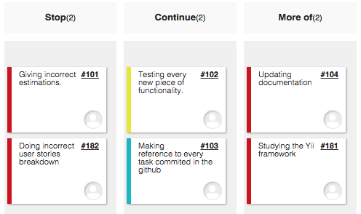
Sprint #1Retrospective

Slide 17




Sprint # 2 Planning
8 Points
8 Points
12 Points
8 Points

